Slide 1


Slide 2
Integrated Systems Planning
Definitions---What is integration?
    Within agency;
    Between agencies;
    Between jurisdictions (local, regional, state, federal).
  The ability to access and share critical information at key decision points throughout the justice enterprise.

Slide 3
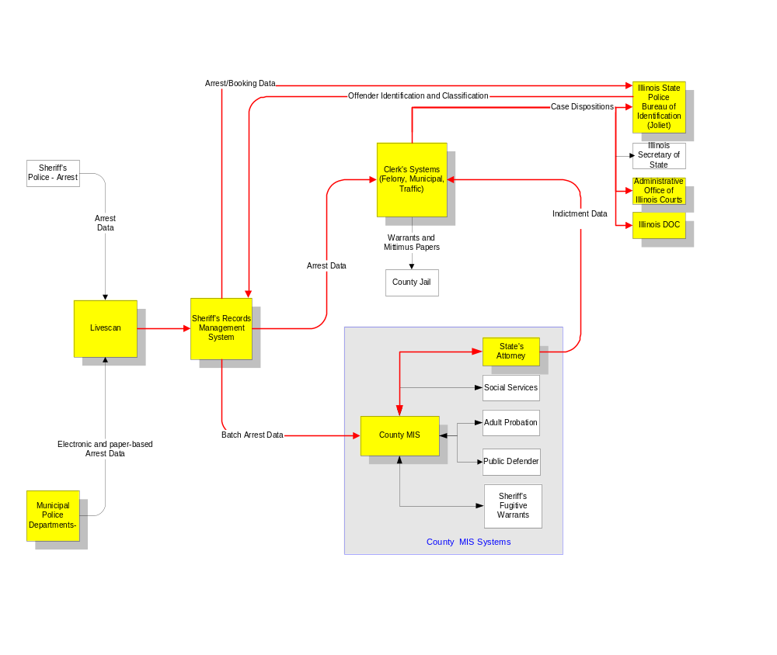

Slide 4
Municipal
County
State
Federal
Police systems: local police records management, livescan, CAD, field-based reporting
Court-related agencies: prosecutor, clerk, social services, probation, defense, etc.
State Agencies: State Police, Corrections, Appellate Prosecutor, Appellate Defender, AOIC
FBI, III, NLETS

Slide 5
Why Integration?
    Elimination of redundant data entry
    Timely and accurate information
    Improved criminal history records
    Coordinated allocation of resources

Slide 6
What integration is not
    Shared state-level criminal history system
    Shared mobile data system
    Shared court docket system
    Unlimited access to offender-based data

Slide 7
Integration Principles
    Data should be captured at the originating point, rather that trying to reconstruct it down line
    Data should be captured once and used many times
    The integrated system should be driven by the operational systems of participating agencies
    Justice agencies should retain the right to design, operate and maintain systems to meet their own operational requirements
    Security and privacy will be priorities in development of integration capabilities

Slide 8
Integration Principles
    Integration will build on current infrastructure
    Establishing and confirming the positive identity of the subject is crucial
    Opportunity to analyze and reengineer justice business processes

Slide 9
Solution: enter once, use many
    Offender-related information is entered directly into a computer system by arresting or reporting officer
    This information is transferred electronically to all “upstream” justice agencies (as needed)
    Information may be enhanced but will never be reentered manually

Slide 10
Integration Functions
    Query local, regional, statewide and national databases;
    Push information to another agency based on actions taken within the originating agency;
    Pull information from other systems for incorporation into the recipient agency system;
    Publish information regarding people, cases, events and agency action; and
    Subscribe to a notification service.

Slide 11
Integration Outcomes
    Ability to exchange info based on locally defined rules
    Minimize redundant data entry
    Provide event notification
    Expedite inter-agency data transfer
    Maximize data integrity
    Provide data access control
    Reduce paper transfers
    Ensure appropriate privacy and security

Slide 12
Purpose
Why are we here?
What needs to be done?
When must it be completed?

Slide 13
Historical Chronology of IIJIS Project
    Criminal Justice Planning Assembly
    NGA Integration Strategy Workgroup
    Formulation of Integration Committee
    Executive Order No. 12 (2001)

Slide 14
Executive Order No. 12 (2001)
Establishment of IIJIS Governing Board
Duties of Board
        Needs Assessment
        Exchange Points Study
        Develop Strategic Plan
        Report findings, recommendations, and strategic plan by 12/31/02

Slide 15
Initiatives proposed to NGA
    Establish an integration governing body
    Conduct a statewide needs analysis with feasibility study and data audit
    Replace paper-based information transfers with electronic “real-time” transfers at known justice information exchange points

Slide 16
Conceptual Task Flow for Prototype to Bridge Exchange Points
Convene
Technical
Committee
Analyze
Agency
Systems
Develop
Data and
Interface
Standards
Build
Data
Exchange
Server
Implement
Limited
Data
Exchange
Extend
Process
to other
Agencies

Slide 17
Why Now?
    Technologies are now available that facilitate integration while using existing systems infrastructure.
    Federal Government is emphasizing justice systems integration.
    It has become clear that paper and batch data exchanges necessitated by autonomous silo systems don’t work very well.

Slide 18
Current Integration
Activity in Illinois
    McLean County consolidated criminal justice information system
    DuPage County automation of specific data exchanges
    Lake County integration planning/ exchange points documentation

Slide 19
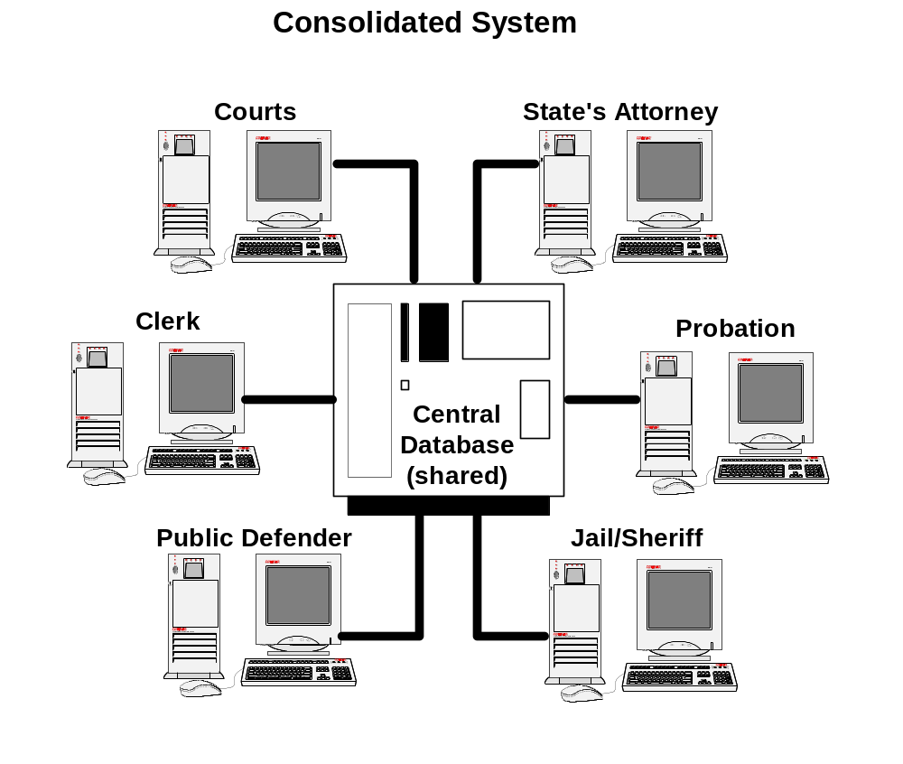

Slide 20
Law
Enforcement
Jail
Probation
Public
Defender
MIS
Shared
Database
Server
Sheriff
Courts
Circuit
Court
Clerk
State’s
Attorney

Slide 21

Department
of Motor
Vehicles
Criminal
History
Repository
Department
of
Corrections
Translation
Push/Pull
State Police
Supreme and
Appellate
Courts

Slide 22
Law
Enforcement
Colorado CICJIS
DEC VAX
DA’s
Council
HP 9000
Judiciary
AS 400
CICJIS
Middleware
Server
Adult
Corrections
Sequent
Judiciary
Data
Warehouse
RS 6000
Youth
Corrections
Sequent

Slide 23
Law
Enforcement
DEC VAX
DA’s
Council
HP 9000
Judiciary
AS 400
CICJIS
Middleware
Server
Adult
Corrections
Judiciary
Data
Warehouse
Sequent
RS 6000
Youth
Corrections
Sequent

Slide 24
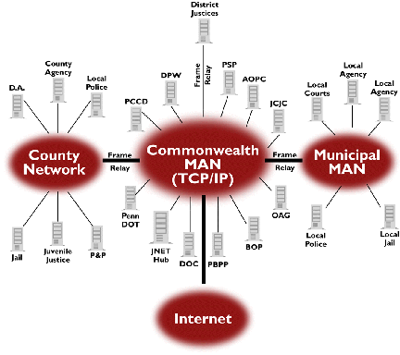
Pennsylvania’s JNET

Slide 25
Illinois Infrastructure
    Illinois Century Network
    State Police LEADS/CHRI Systems
    AOIC Polaris System
    Southern District U.S. Attorney System
    Chicago Police CLEAR System
    Illinois Automated Victim Notification

Slide 26
Translation
Push/Pull
Sheriff’s
CABS
Livescan
Network
CPD
Systems
Clerk’s
System
ISP
Systems

Slide 27
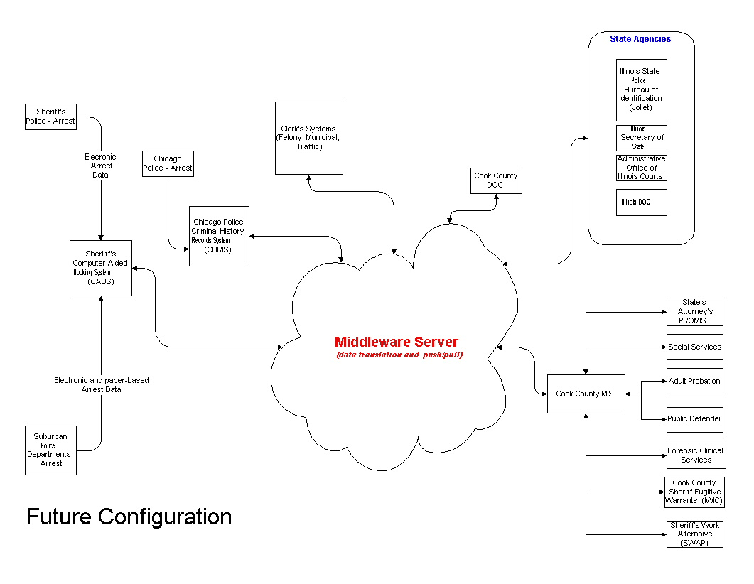

Slide 28

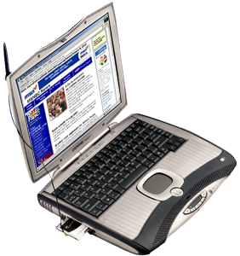

Police
Prosecution
Local
Agencies
Jail
Courts
Portals
Middle-
ware
Servers
Data
Warehouse
U.S.
Attorney
(Southern
District)
AOIC
(Polaris)
ISP
(LEADS
/CHRI)
DOC
SOS
CPD
(CLEAR)

Slide 29
Local and State Responsibilities
Local
    Systems that meet the day-to-day operational needs of the agencies involved
    Ability to share operational data between local agencies within a jurisdiction
State
    Build statewide information repositories that support the operational needs of local and state users
    Build and support infrastructure that enables the automated sharing of information between jurisdictions

Slide 30
Local and State Responsibilities
State (continued):
    Develop and support standards consistent with national standards to enable sharing of information between local jurisdictions, to state systems and other states, as well as national systems; and
    Provide leadership, collaboration and funding, where available and necessary.

Slide 31
IIJIS Planning Committee
    Reexamine Vision Statement
    Develop operational requirements
    Coordinate strategic plan for statewide justice information integration

Slide 32
IIJIS Technical Committee
    Oversee statewide needs assessment survey
    Create detailed justice exchange points model (SEARCH tool)
    Adopt data exchange standards

Slide 33
Initiate needs assessment process
    While much is known about the Illinois justice information systems environment, significant gaps exist
    Needs assessment process will document existing justice systems environment and infrastructure
    Justice information exchange points — actual and potential—will be identified

Slide 34
Information Exchange
Points Project
    Meets NGA criterion for a project that will produce a tangible outcome in 12 - 24 months
    Exchange points tool and support is now available from SEARCH
    Agencies are interested in participating

Slide 35
Exchange Point Dimensions
    The event that triggers the information exchange, i.e., arrest, indictment, sentencing, release, etc.
    The agencies involved in the information exchange
    The information actually exchanged between agencies, i.e., data elements, documents, images, etc.
    The exchange conditions are the factors that govern the exchange and define the processing flow (how, what, where and with whom)

Slide 36
Adopt Data Exchange Standards
    Examine data exchange standards now in development by NLETS, Global, Legal XML and others
    Adapt national standards to Illinois’ purposes
    Supplement national standards with new Illinois standards to deal with unique data items

Slide 37
IIJIS Activities to Date
    Executive Order No. 12 (2001) signed by Governor Ryan
    Grant funds received from NGA/Byrne
    Management and administrative support staff hired
    IIJIS website www.icjia.state.il.us/iijis
    Integration “White Papers”

Slide 38
IIJIS Activities to Date
    Staff training from SEARCH group on Data Exchange Points Model
    IIJIS Governing Board meetings
    Needs Assessment Survey draft

